Slide 1
Indego Bike Share
Hima Gharat, Steve Pennington, Leslie Vazquez, Sadik Muktar

Slide 2
4,000,000
1,400
140
Rides taken on Indego bikes since 2015
Electric and Classical Bikes
Bicycle Stations
Notes:
Before we jump in, i just wanted to give a few fun facts about the indego bike sharing program- 4M rides were taken on indego bikes since the inception of the program and there are 1400 electric/classic bikes w/ 140 bike docs.
Seeing the popularity of bike shares is what piqued our interest in this topic.
We found that there was a shortage of bikes available for purchase during the pandemic so this led us to wonder if there is a shortage of bikes to purchase, would the public be more likely to look at bike rentals as an option?
Created a dashboard for someone to look into this and determine if bike sharing/renting bikes is actually increasing.

Slide 3
Context of Research
Passholder Comparison
Bicycle Analysis
Notes:
We focused on 2 aspects of the bike sharing program: passholder comparison and bicycle analysis. There are multiple types of passes ranging from daily, weekly, monthly and 2 types of bikes- electric and classic.
We focused on data from q2 and q3 from 2019 and 2020.
We used 2019 as the baseline for our analysis as this was pre-covid and we wanted to see how/if the pandemic has impacted bike sharing/rentals.

Slide 4
01
Jupyter Notebook
Notes:
Let’s jump right into our process.
Our first step was to clean up the data. (Next slide please)

Slide 5
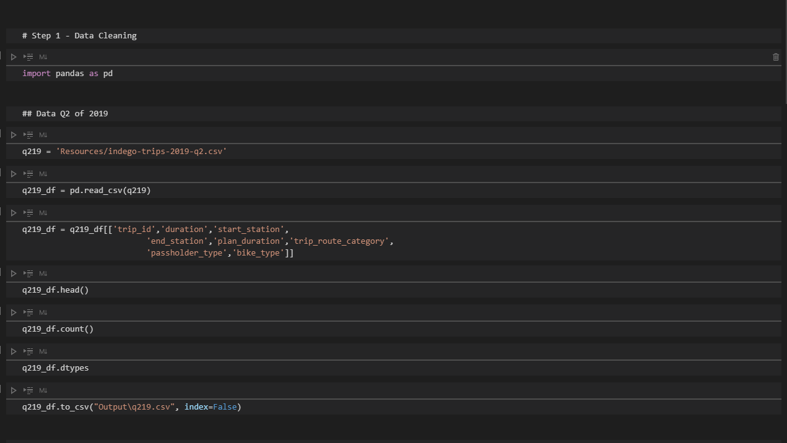
Step 1: Clean Data in Jupyter Notebook
Notes:
We started off with 4 csv files (2019 q2/3 and 2020 q2/3) and there were about 1.2 million data units between these 4 files.
The data was mostly clean but we were focused on passholders and bike analysis so we needed to narrow down the data.

Slide 6
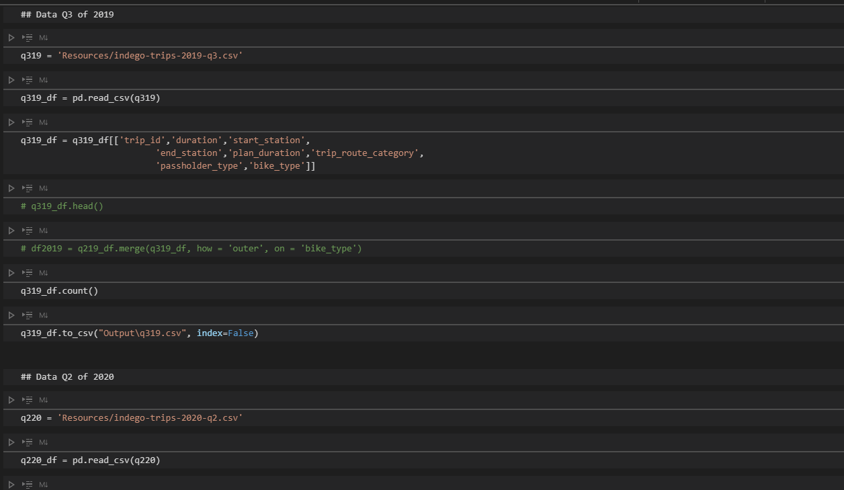
Jupyter Notebook

Slide 7
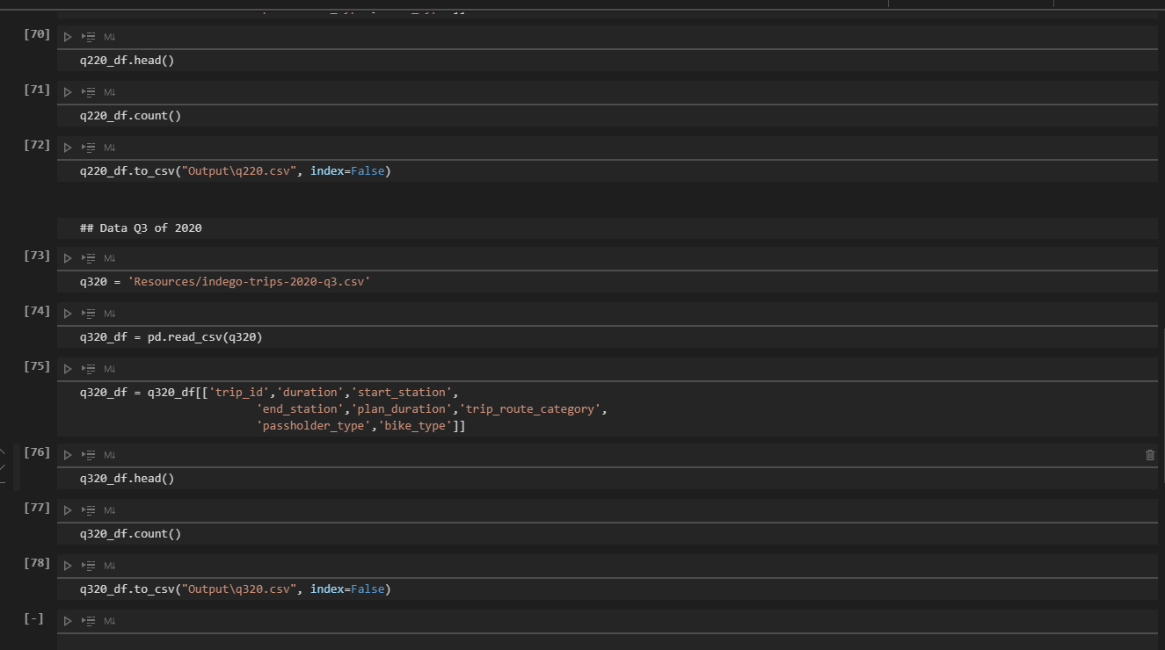
Jupyter Notebook
Notes:
The data was relatively clean but we focused on passholder info and bike types so we wanted to focus on those only
We pulled out the excess columns and data to prep for the next step which was to create the Pymongo Database (pass along to Leslie)

Slide 8
02
Connect to MongoDB

Slide 9
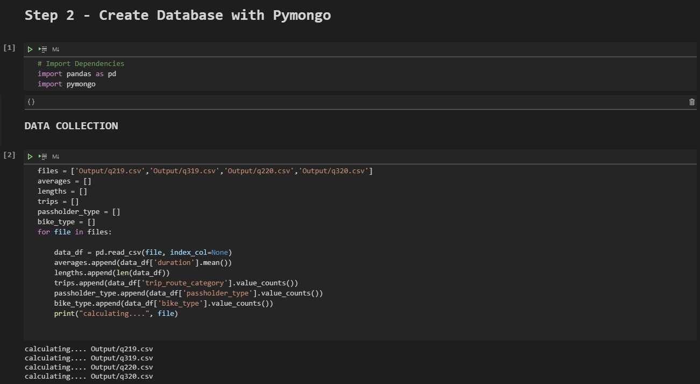
Jupyter Notebook

Slide 10
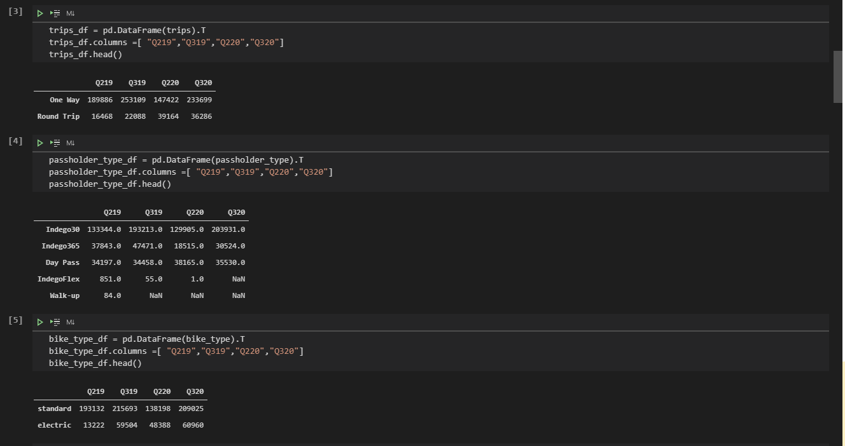
Jupyter Notebook

Slide 11
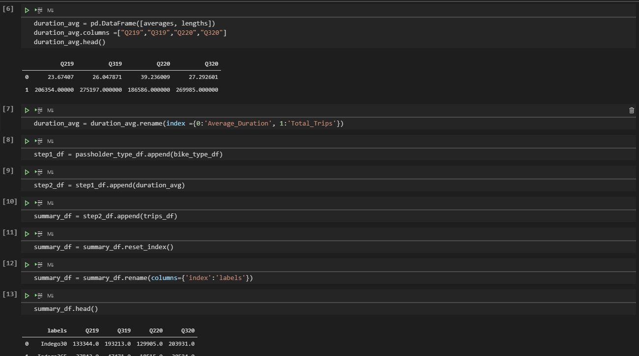
Jupyter Notebook

Slide 12
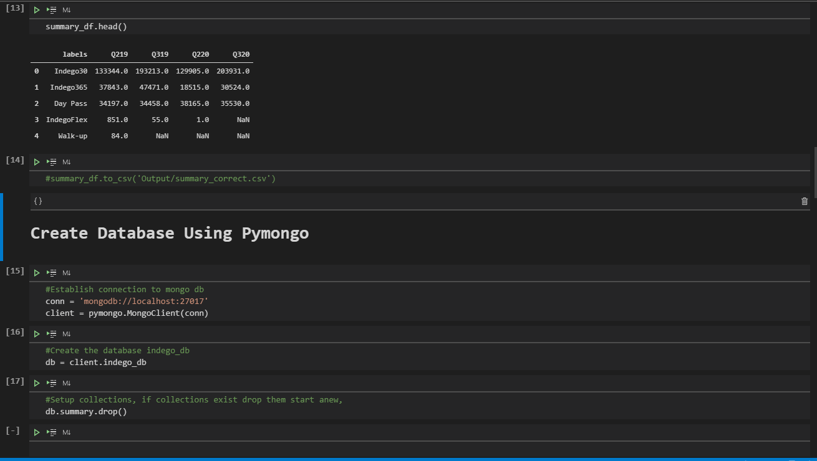
Jupyter Notebook

Slide 13
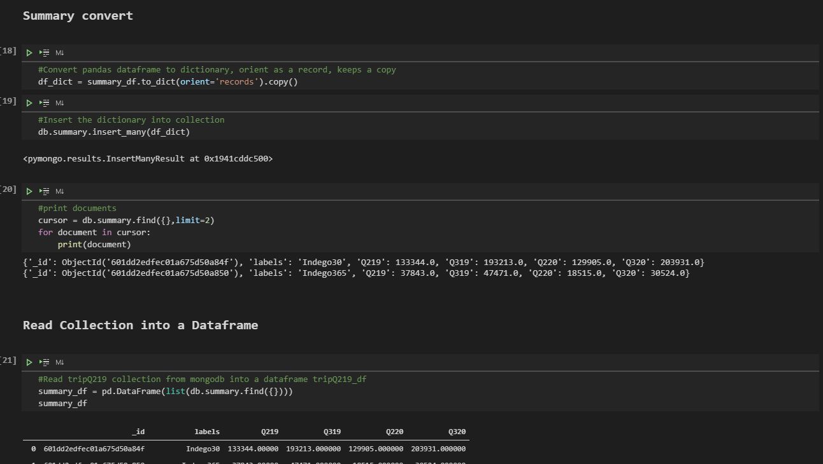
Jupyter Notebook

Slide 14
03
Connecting to Flask

Slide 15
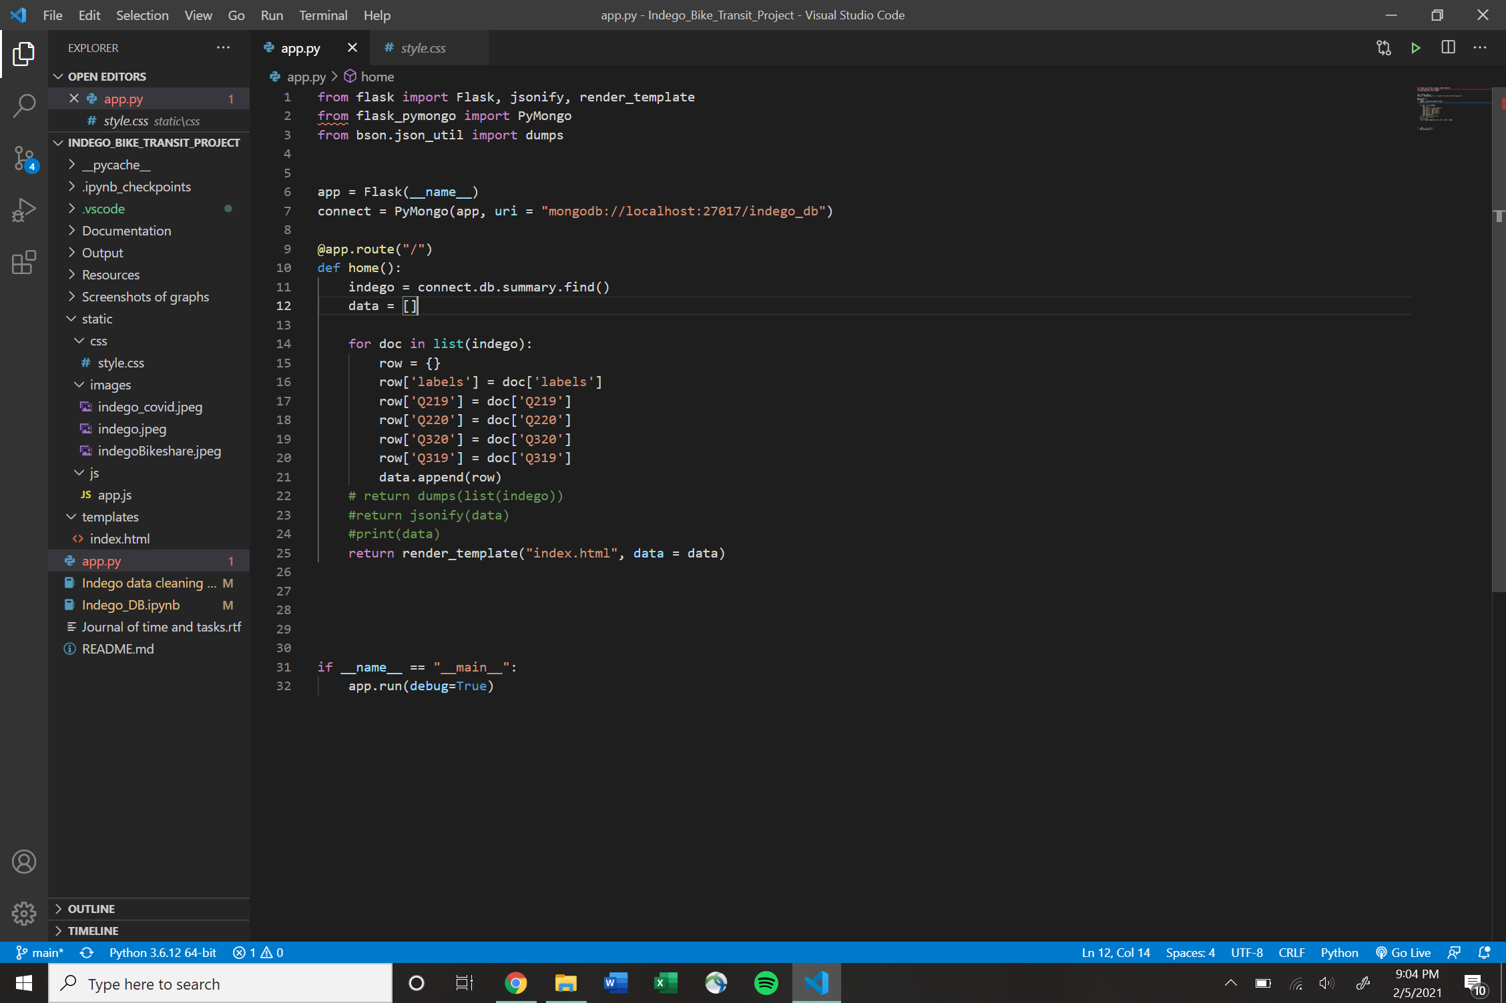
Step 2: Connecting to Flask

Slide 16
04
Create Visualizations

Slide 17
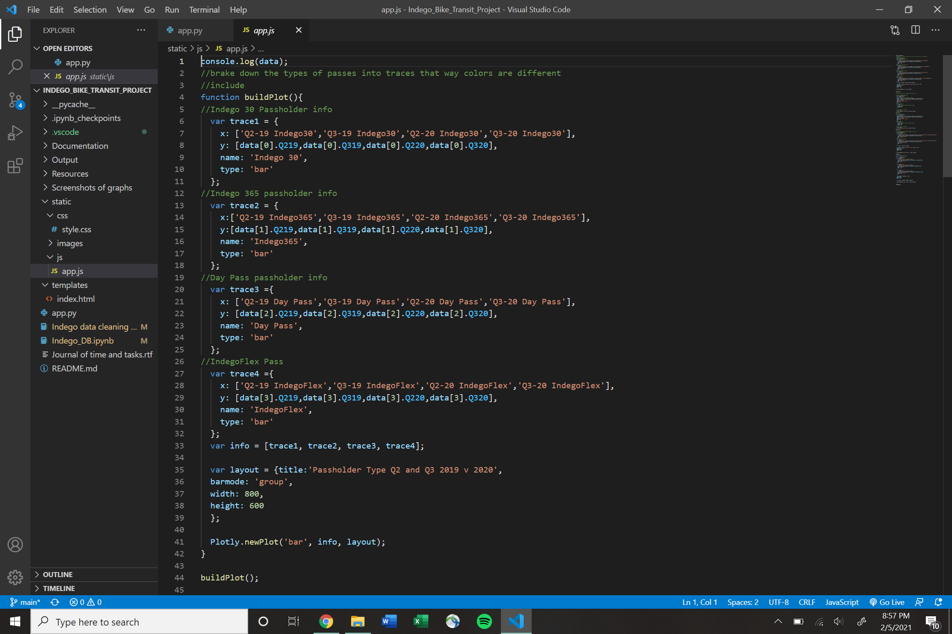
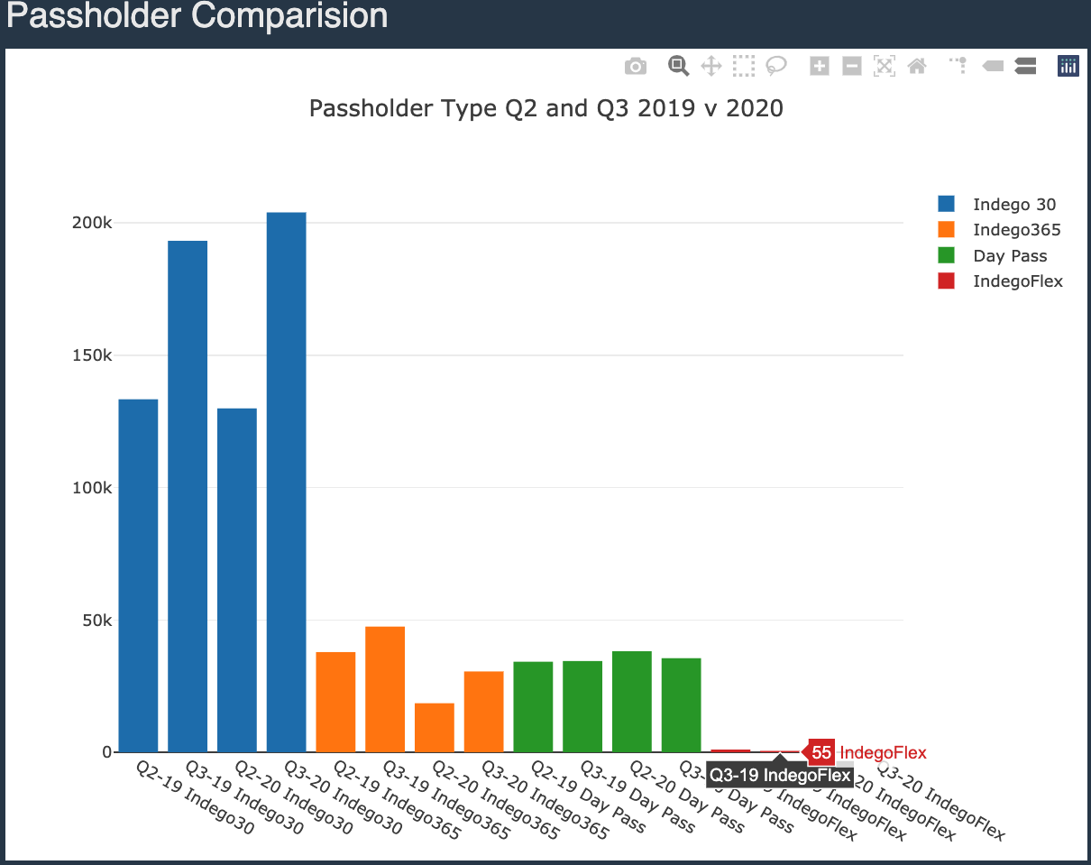
Step 3: Create Visualizations

Slide 18
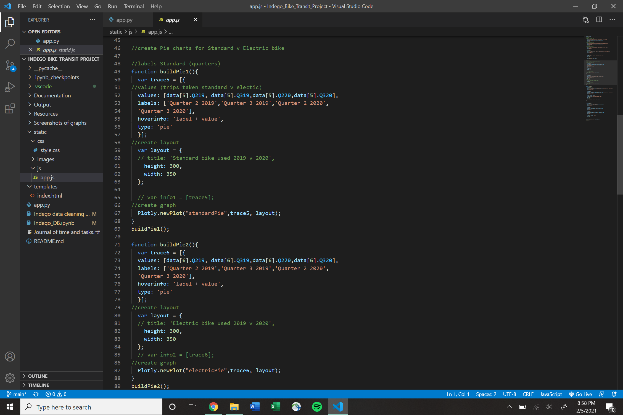
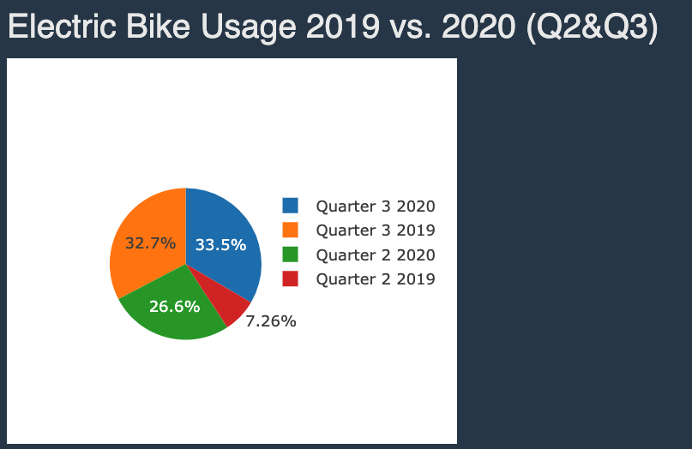
Javascript

Slide 19
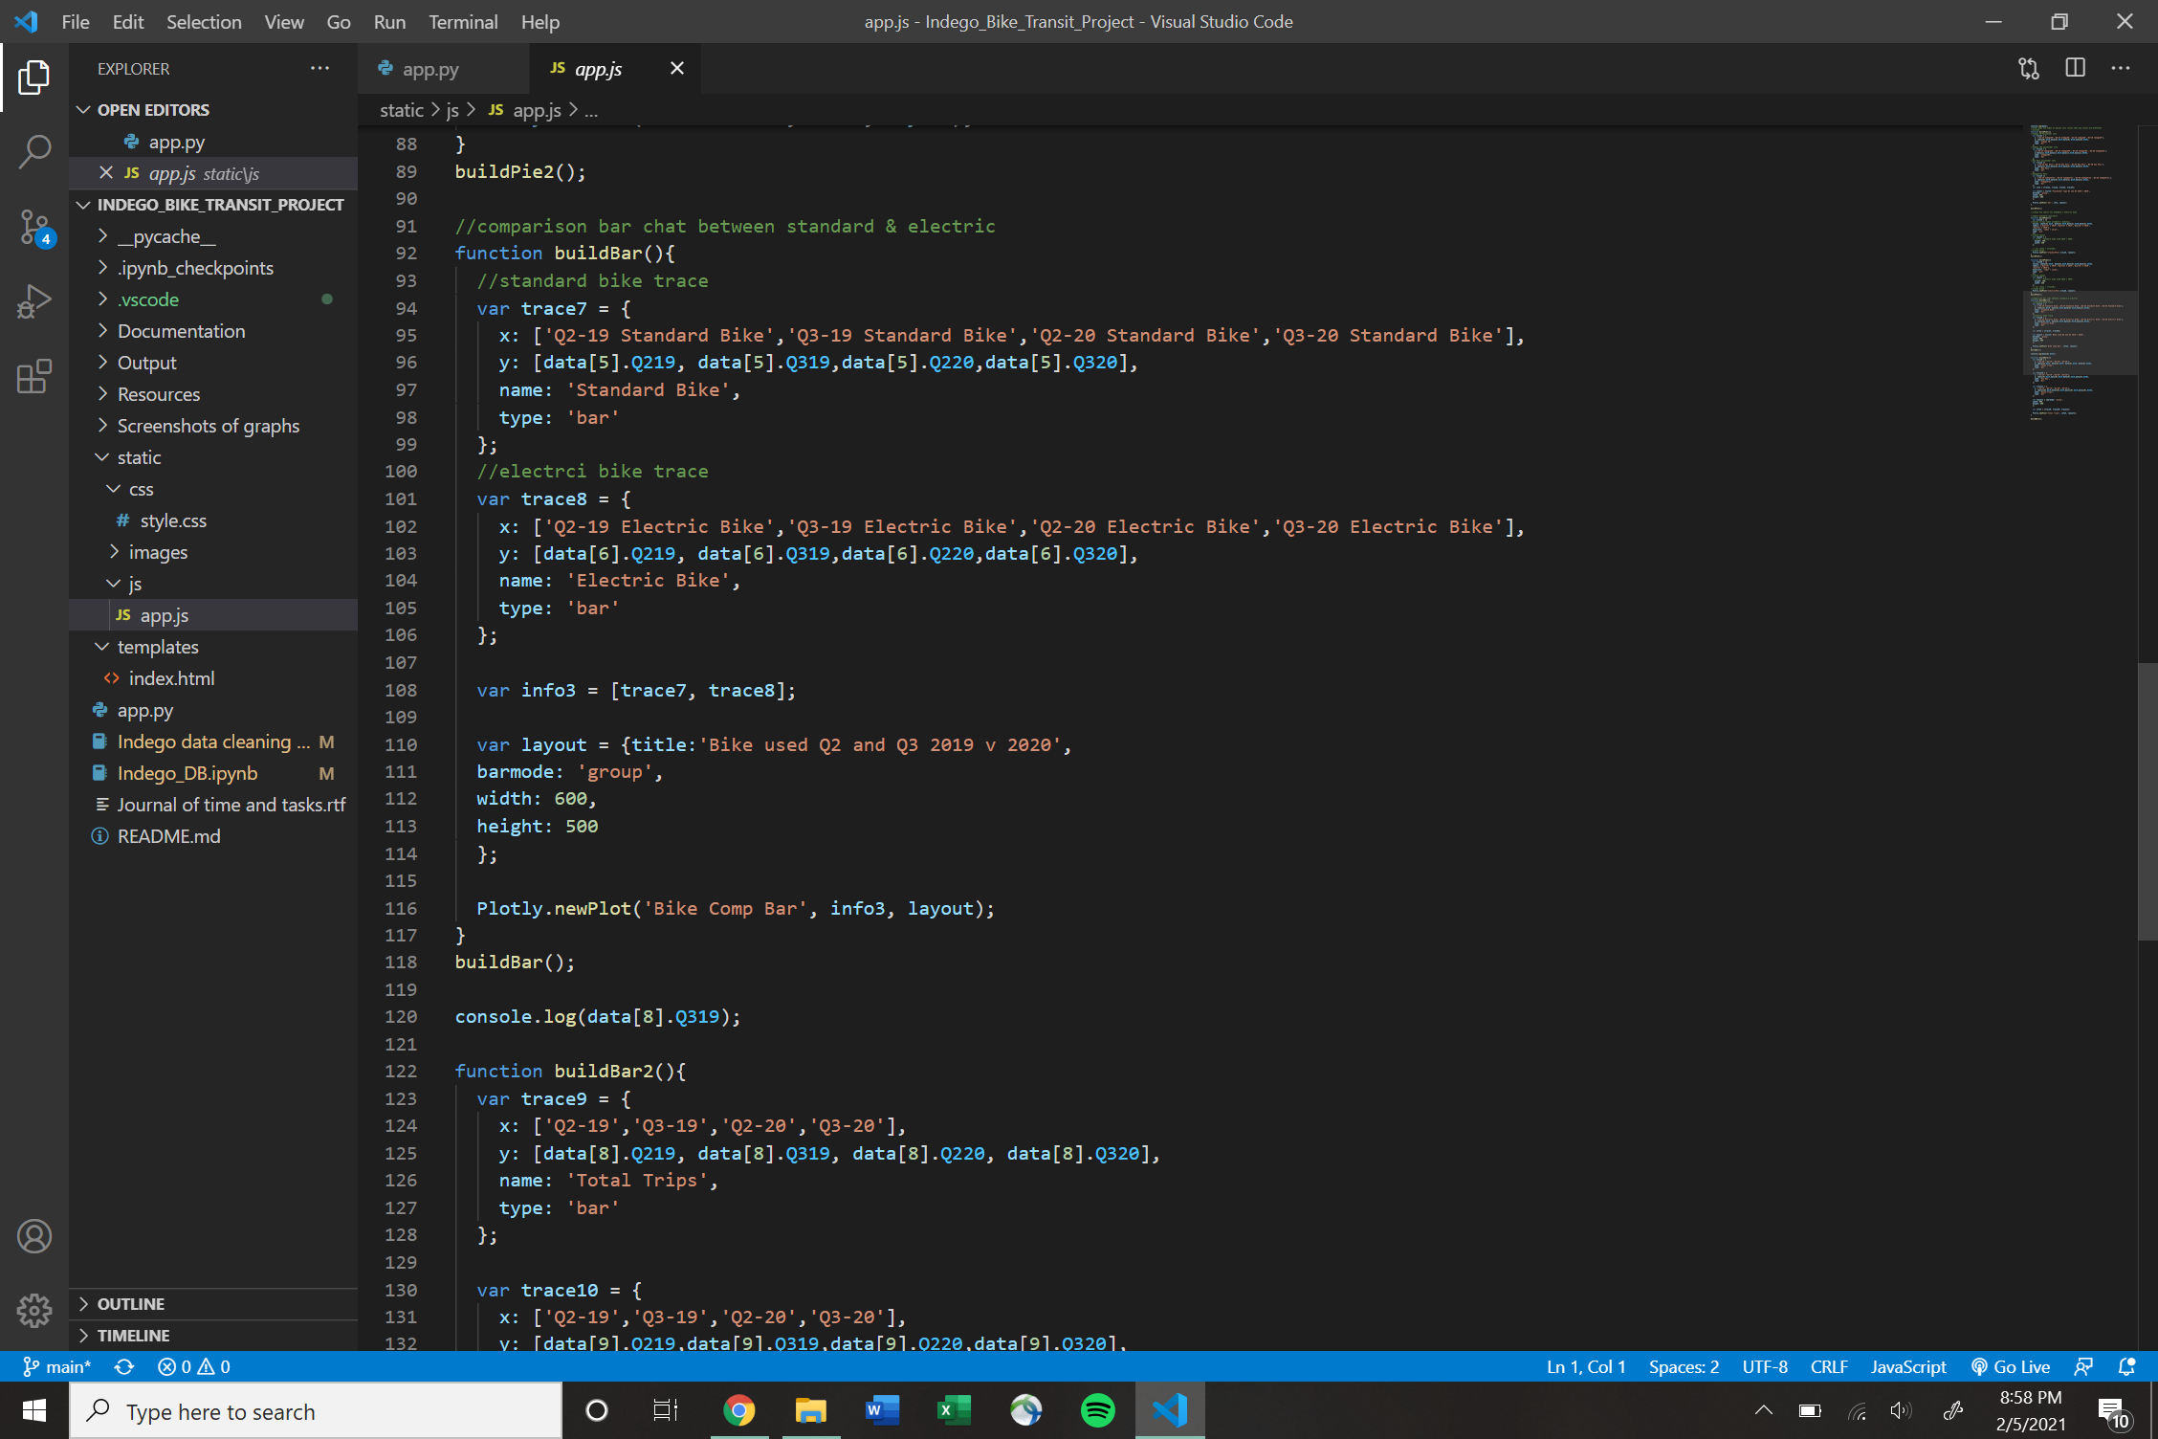
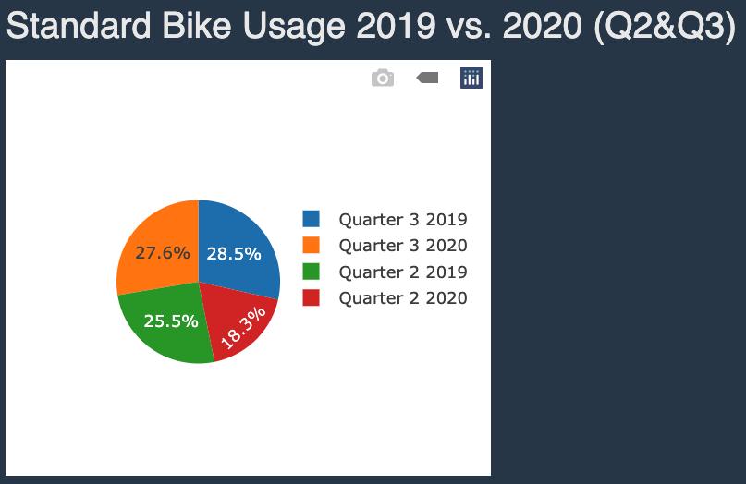
Javascript

Slide 20
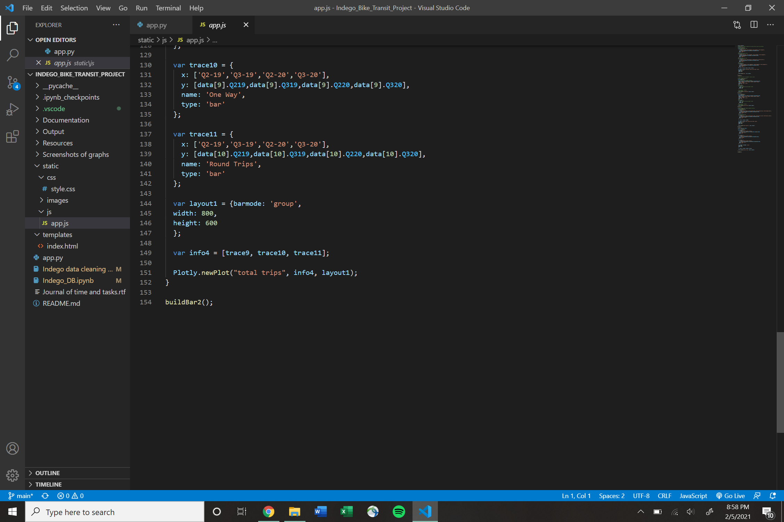
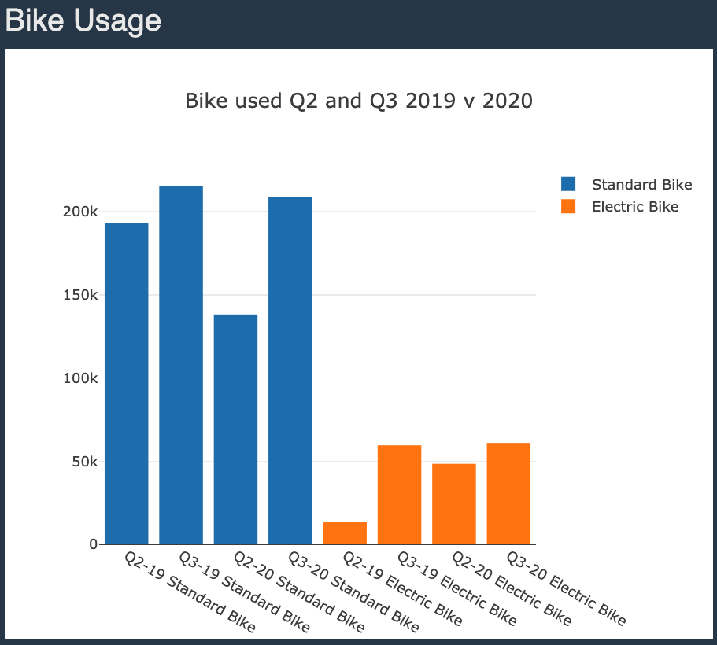
Javascript

Slide 21
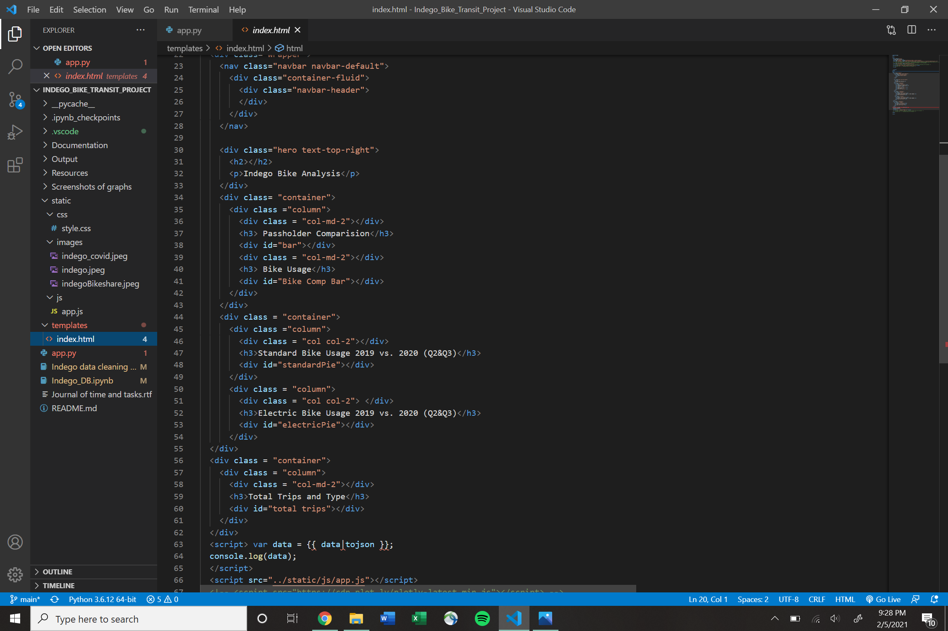
HTML

Slide 22
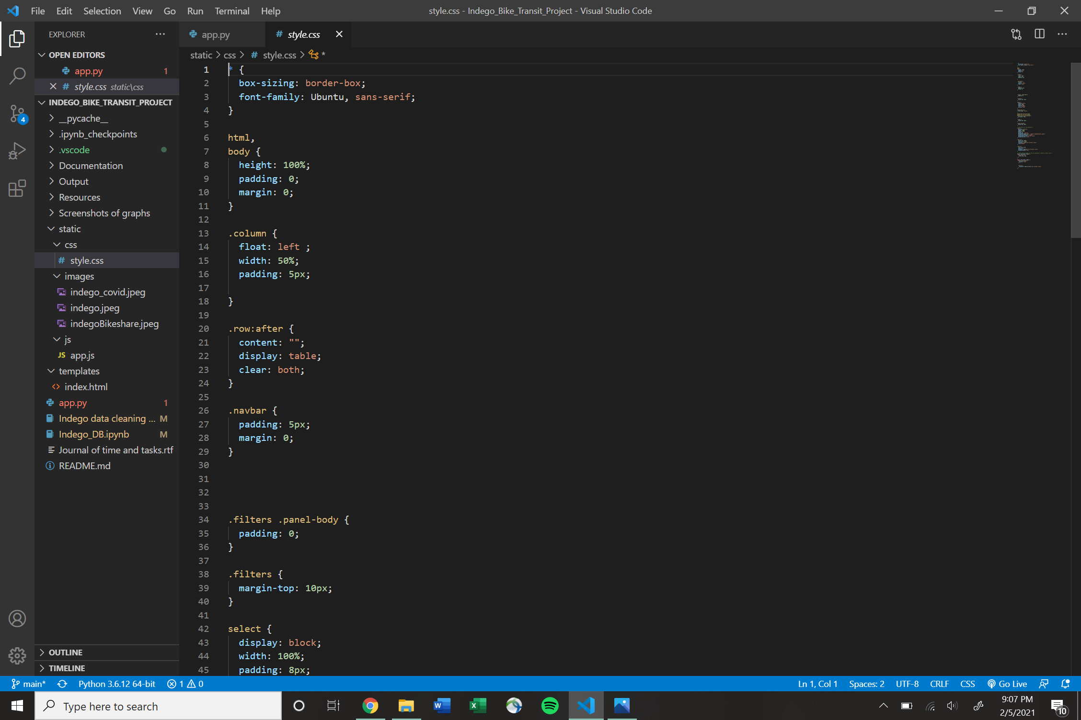
CSS

Slide 23
Questions?

